Slide 1

K Fold Cross Validation
Under-fitting
Over-fitting

Slide 2
K Fold Cross Validation
Cross-validation is a resampling procedure used to evaluate machine learning models on a limited data sample.
The procedure has a single parameter called k that refers to the number of groups that a given data sample is to be split into.
Training
100 Math Questions

Slide 3

K Fold Cross Validation
Option-1
Re-Substitution
20
20
20
20
20
Trained
Test
Few Questions
from 100 Questions
100 Math Questions

Slide 4
K Fold Cross Validation
Option-2
Holdout
20
20
20
20
20
Trained
Test
20 Questions
from100 Questions
80 Math Questions
From 100 Questions

Slide 5
K Fold Cross Validation
Option-3
K Fold Cross Validation
Here, K=5

Slide 6


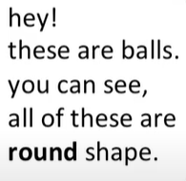

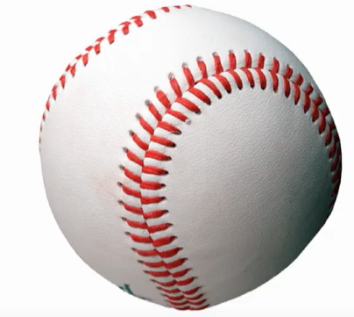
Underfitting

Slide 7

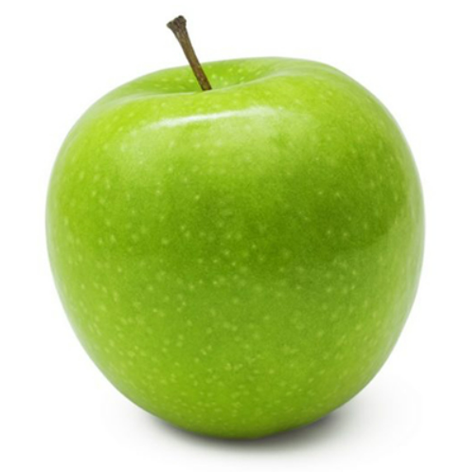
Underfitting
Test

Slide 8
Underfitting
Option-2
Holdout
(You refused to accept something)
20
20
20
20
20
Trained
Test
20 Questions
from100 Questions
80 Math Questions
From 100 Questions

Slide 9
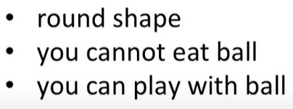
Underfitting

Slide 10
Solved Underfitting
Test
It is not ball

Slide 11
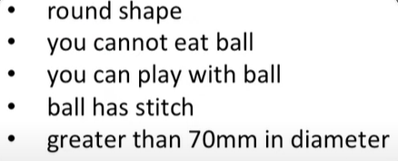
Overfitting

Slide 12

Overfitting
Test
It is not ball
It is not ball

Slide 13
Overfitting
Option-1
Re-Substitution
20
20
20
20
20
Trained
Test
Few Questions
from 100 Questions
100 Math Questions

